Slide 1
Award Ceremony
2012 IEEE Haptics Symposium
March 4-7, 2012 | Vancouver, Canada

Slide 2
Awards
Sponsored by
Best Teaser Award
Best Poster Award
Best Student Paper Award
Best Paper Award
Best Demo Awards
Notes:
Company Representatives:
Force Dimension: Francois Conti (maybe)
MOOG: Piet Lammertse (plammertse@moog.com, direct 31-252462065, mobile 31-650204952, MOOG Netherlands)

Slide 3
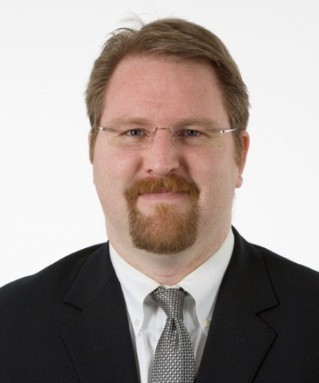
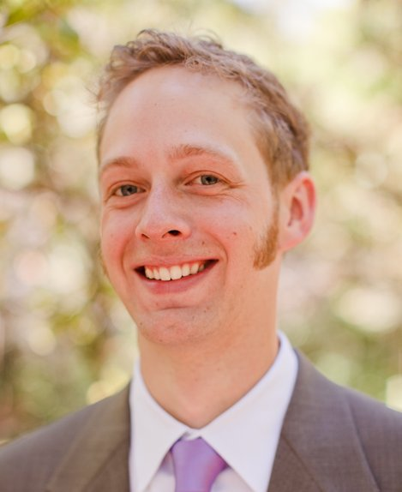
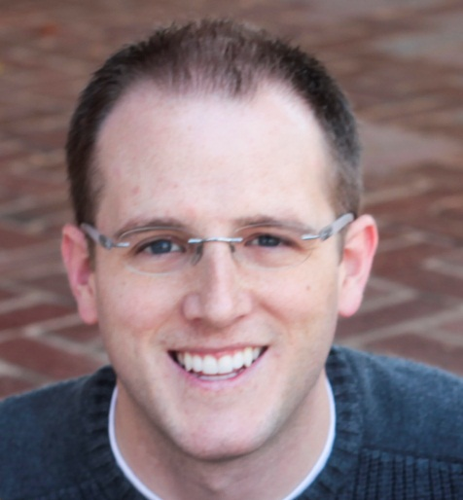
Selection of Best Teaser Award
Voted by YOU – the conference attendees
Organized and tallied by an ad-hoc committee
Will Provancher
Brian Gleeson
James Gwilliam

Slide 4
2012 IEEE Haptics Symposium
March 4-7, 2012 | Vancouver, Canada
Best Teaser Award
Sponsored by
“User Performance in Complex Bi-manual Haptic Manipulation with 3 DOFs vs. 6 DOFs,”
Rene Weller, Gabriel Zachmann
________________________ ________________________________________________________
Chair, Awards Committee Co-Chairs, HS 2012

Slide 5
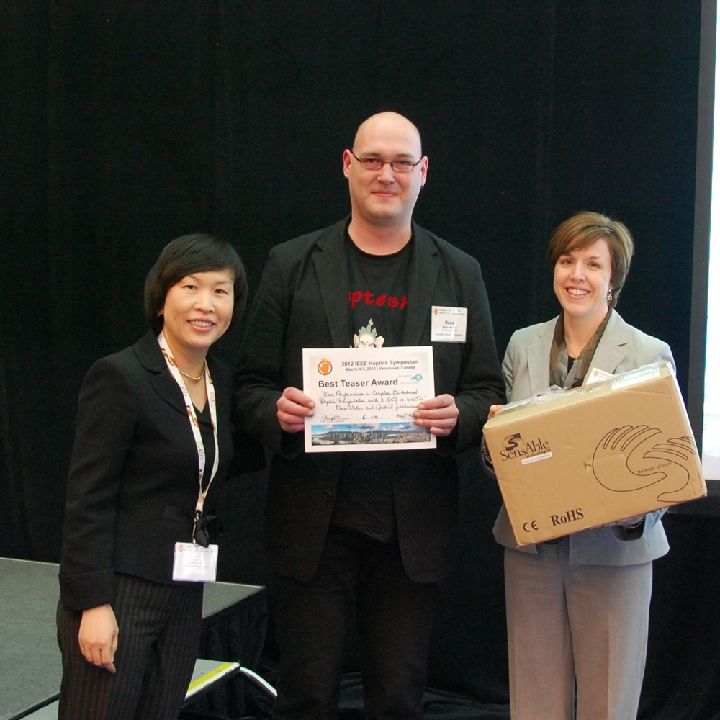
Best Teaser Award

Slide 6
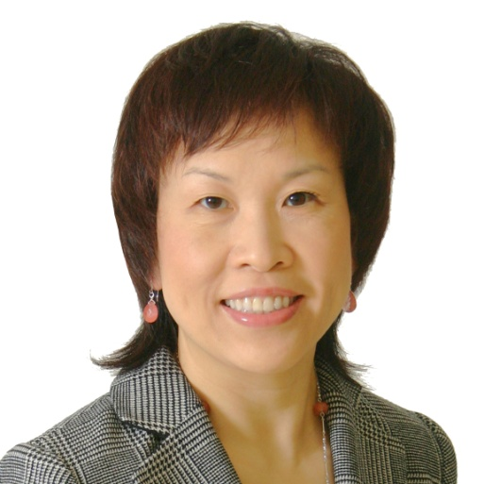
Selection of Best Poster, Best Student Paper, and Best Paper Awards
Candidates nominated by Conference Program Committee
Winner selected by a Best Paper Awards Committee
Antonio Frisoli
Lynette Jones
Jeha Ryu
Hong Tan (Chair)

Slide 7
2012 IEEE Haptics Symposium
March 4-7, 2012 | Vancouver, Canada
Sponsored by
Best Poster Award
“ActivePaD Surface Haptic Device,”
Joe Mullenbach, Dan Johnson, J. Edward Colgate, Michael A. Peshkin
________________________ ________________________________________________________
Chair, Awards Committee Co-Chairs, HS 2012

Slide 8
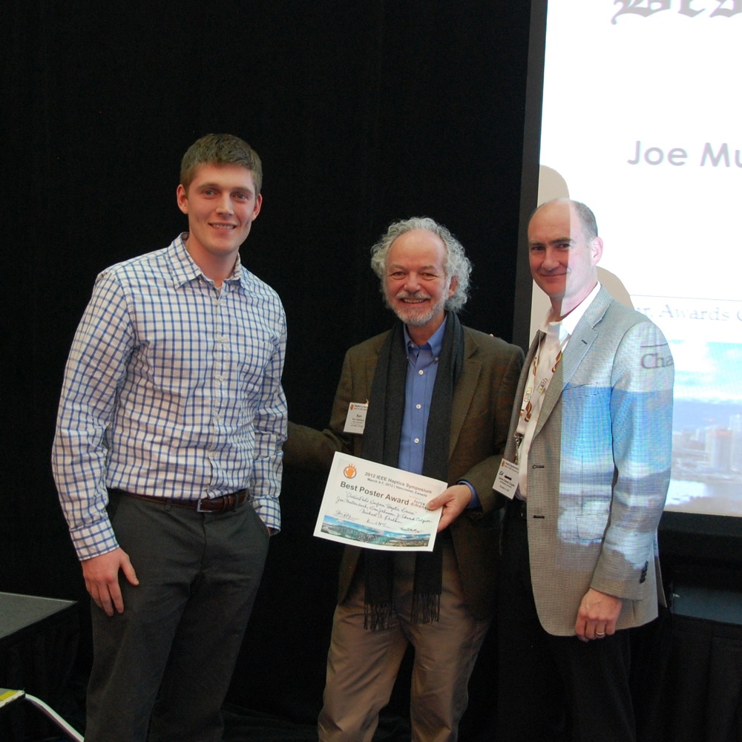
Best Poster Award

Slide 9
2012 IEEE Haptics Symposium
March 4-7, 2012 | Vancouver, Canada
Best Student Paper
Sponsored by
“Co-Location of Force and Action Improves Identification of Force-Displacement Features,”
Jeremy D. Brown, R. Brent Gillespie, Duane Gardner, Emmanuel A. Gansallo
________________________ ________________________________________________________
Chair, Awards Committee Co-Chairs, HS 2012

Slide 10
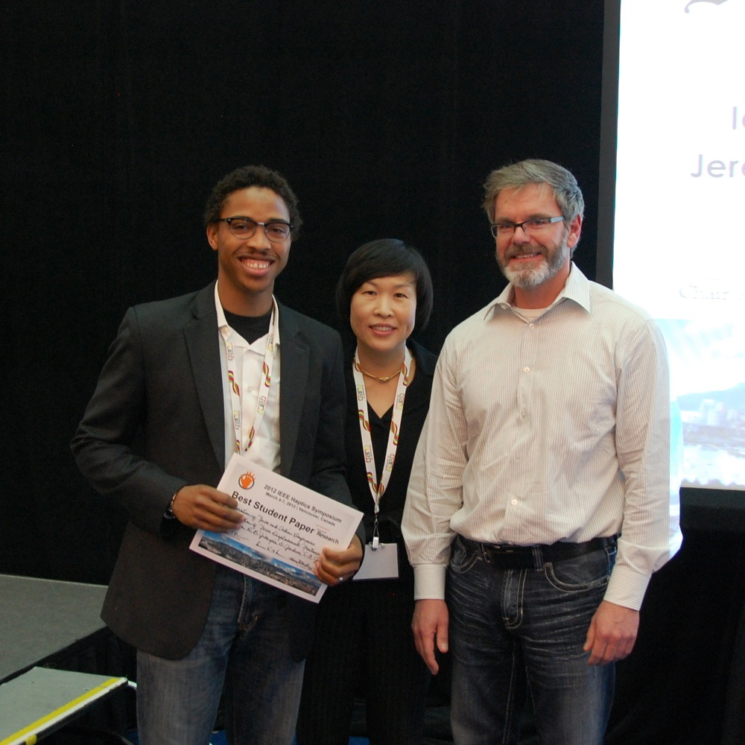
Best Student Paper

Slide 11
2012 IEEE Haptics Symposium
March 4-7, 2012 | Vancouver, Canada
Best Paper Award
Sponsored by
“Exploring the Design Space of Programmable Friction for Scrolling Interactions,”
Vincent Levesque, Louise Oram, Karon MacLean
________________________ ________________________________________________________
Chair, Awards Committee Co-Chairs, HS 2012

Slide 12
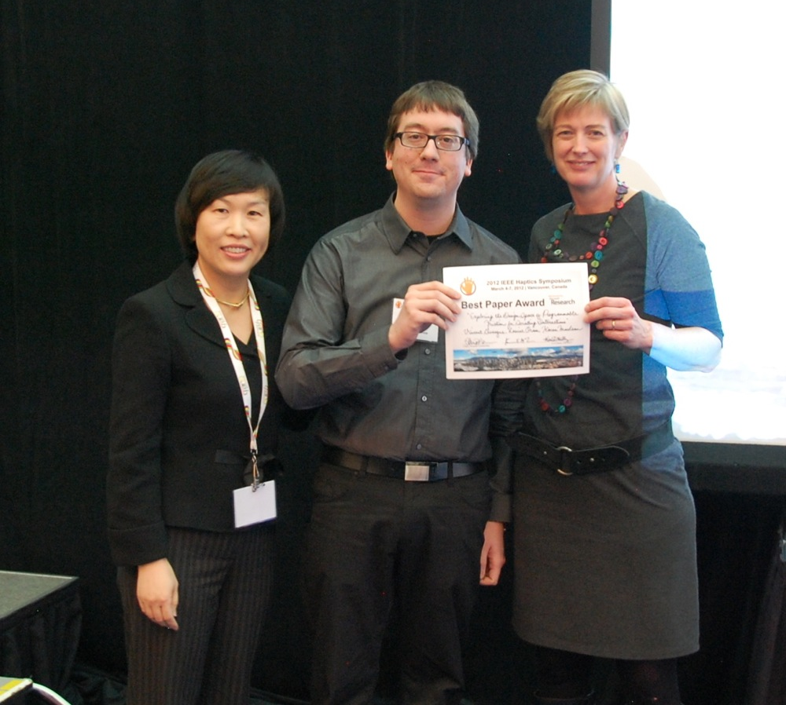
Best Paper Award

Slide 13
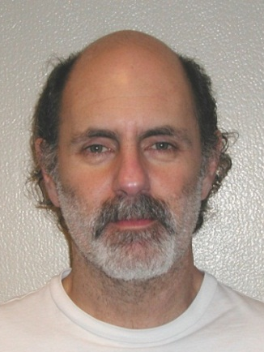
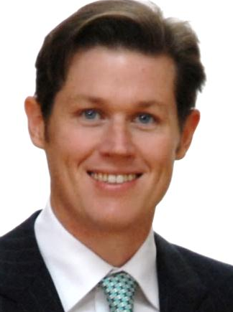
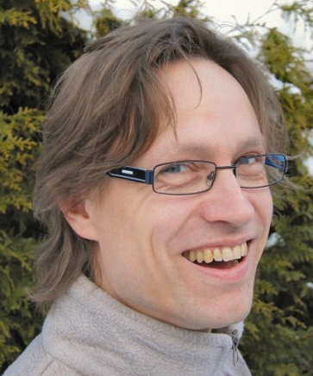
Selection of Best Demo Awards
All demos eligible for the award
Winner selected by a Best Demo Award Committee
Greg Gerling (Co-Chair)
Hong Tan
(Co-Chair)
Jeha Ryu
Dov Adelstein
Topi Kaaresoja
Ken Salisbury

Slide 14
2012 IEEE Haptics Symposium
March 4-7, 2012 | Vancouver, Canada
Best Demo Award
Sponsored by
“A Haptically Accurate Practice Carillon”
Joey Brink, Ying (Jean) Zheng, John Morrell
________________________ ________________________________________________________
Chair, Awards Committee Co-Chairs, HS 2012

Slide 15
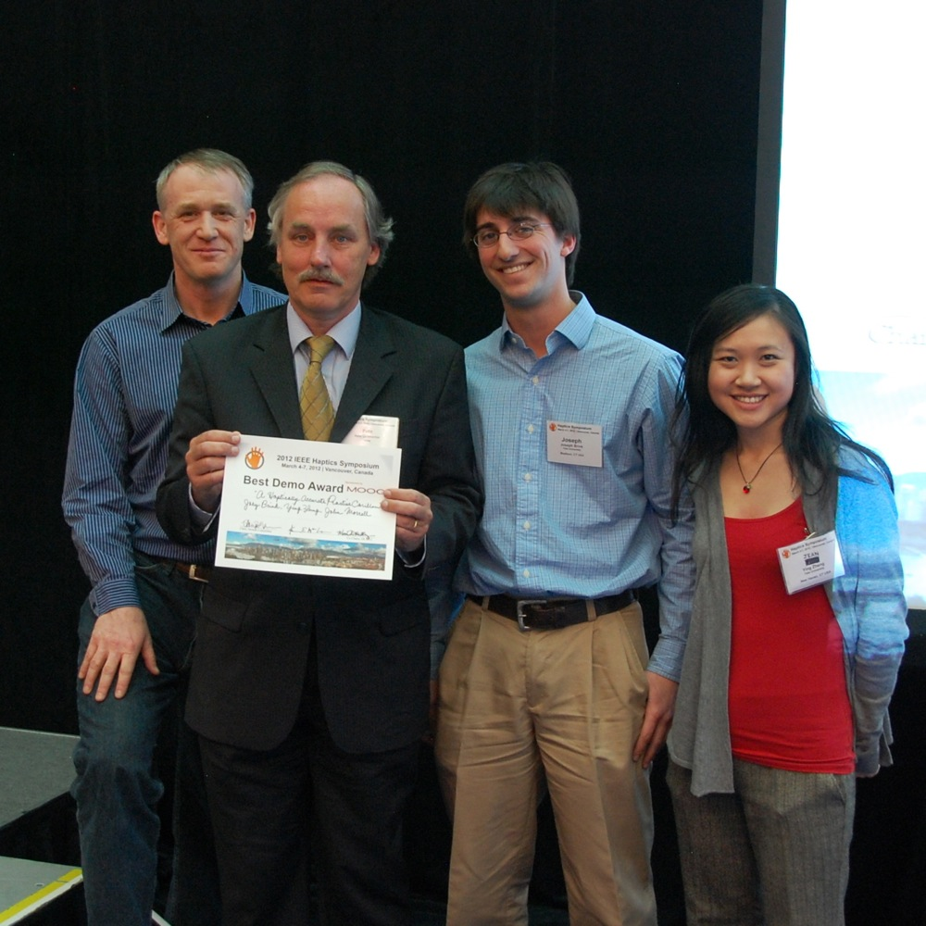
Best Demo Award

Slide 16
2012 IEEE Haptics Symposium
March 4-7, 2012 | Vancouver, Canada
Best Demo Award
Sponsored by
“VerroTeach: Visuo-Audio-Haptic Training for Dental Caries Detection,”
Margrit P. Maggio, Robert Parajon, Katherine J. Kuchenbecker
________________________ ________________________________________________________
Chair, Awards Committee Co-Chairs, HS 2012

Slide 17
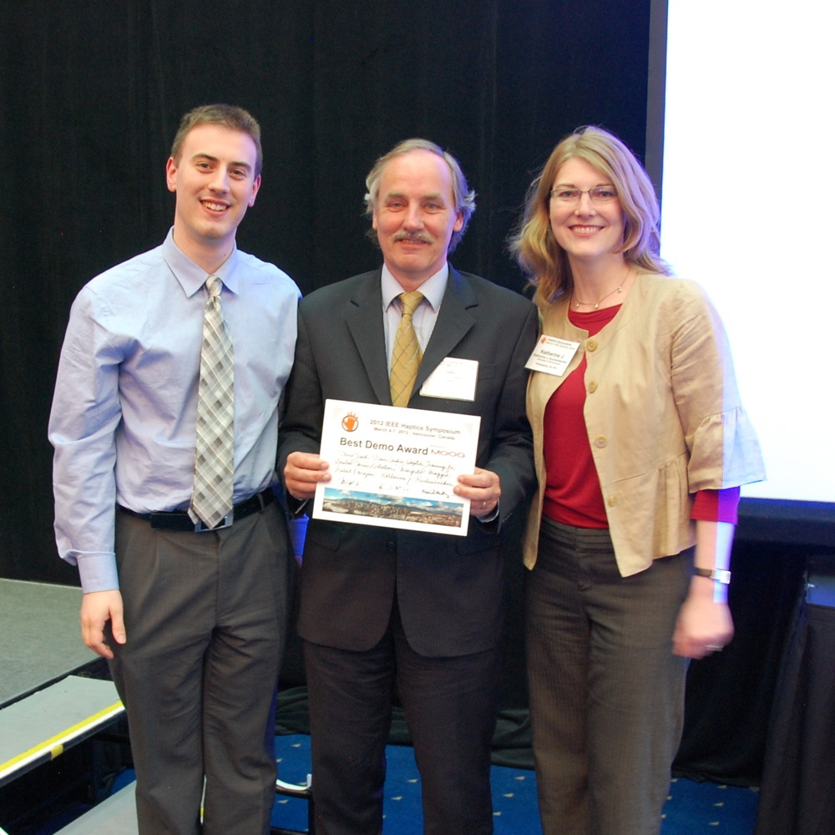
Best Demo Award

Slide 18
2012 IEEE Haptics Symposium
March 4-7, 2012 | Vancouver, Canada
Best Demo Award
Sponsored by
“TECHTILE Toolkit,”
Kouta Minamizawa, Masashi Nakatani, Yasuaki Kakehi, Soichiro Mihara, Susumu Tachi
________________________ ________________________________________________________
Chair, Awards Committee Co-Chairs, HS 2012

Slide 19
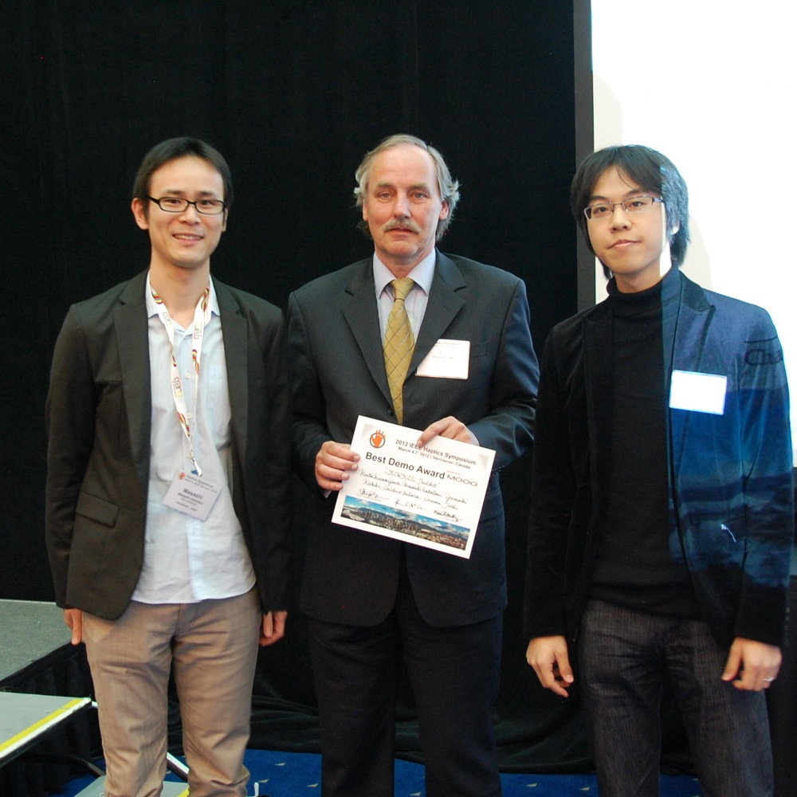
Best Demo Award

